Slide 1

TRANSPORTATION MANAGEMENT SYSTEM
BY
BLACK HAWKS

Slide 2


Meet The Team…..
Jainish Patel
Keerte Dutt
Shrey Patel
Raj Dudhat

Slide 3

ADMIN

Slide 4
ADMIN
In Admin there are total 5 types of work to do:
1. Selecting directories for log files
2. Targeting IP address and Ports
3. Review Log files
4. Alter Table Data
5. Backup Job - Using MysqlDump Tool

Slide 5
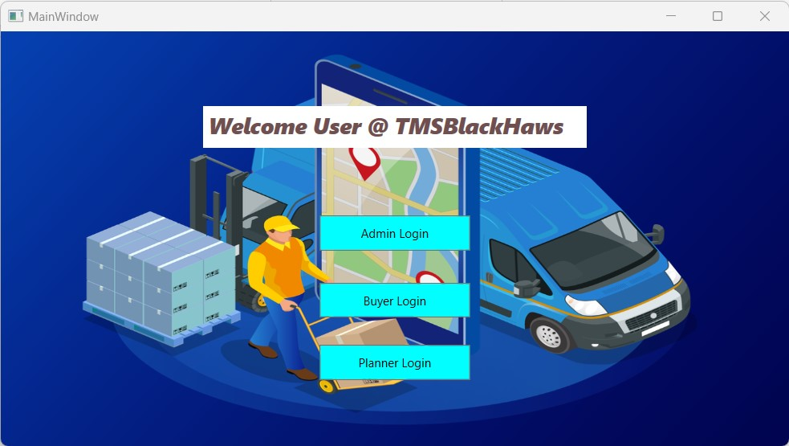
MAIN INTERFACE

Slide 6
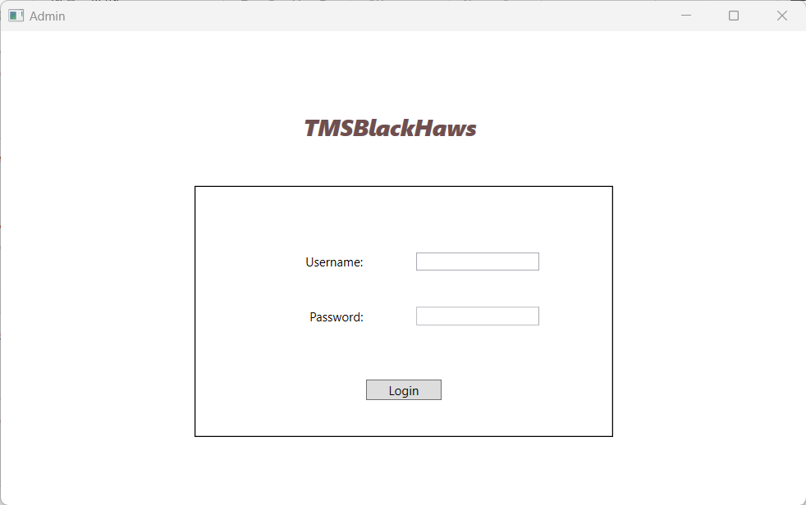
ADMIN LOGIN PAGE

Slide 7
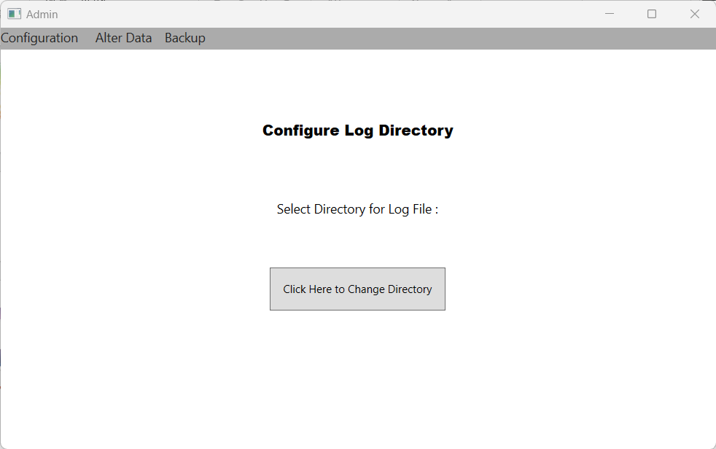
CONFIGURATION LOG DIRECTORY

Slide 8
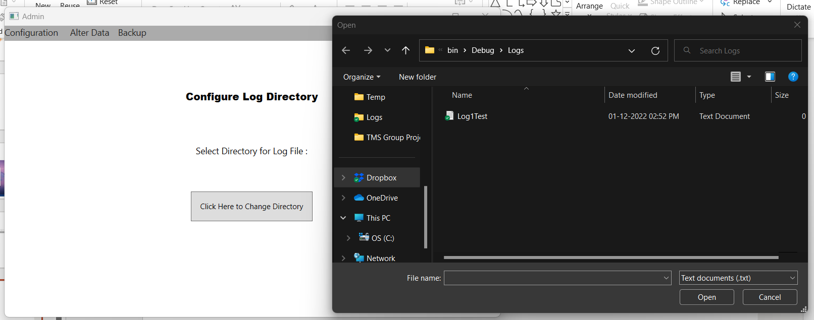
CONFIGURATION DIRECTORY CONTINUED

Slide 9
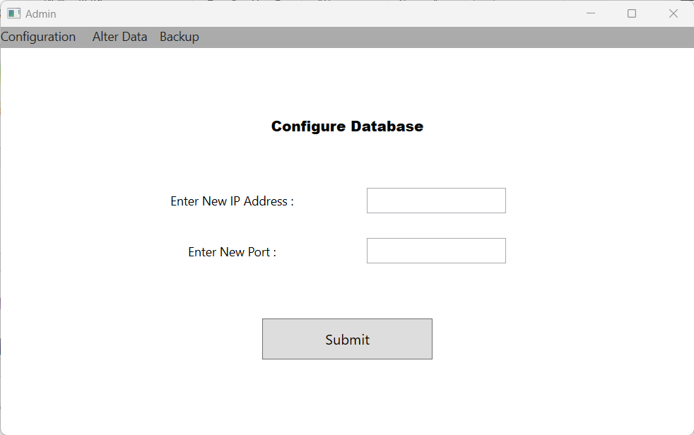
CONFIGURATION DATABASE

Slide 10
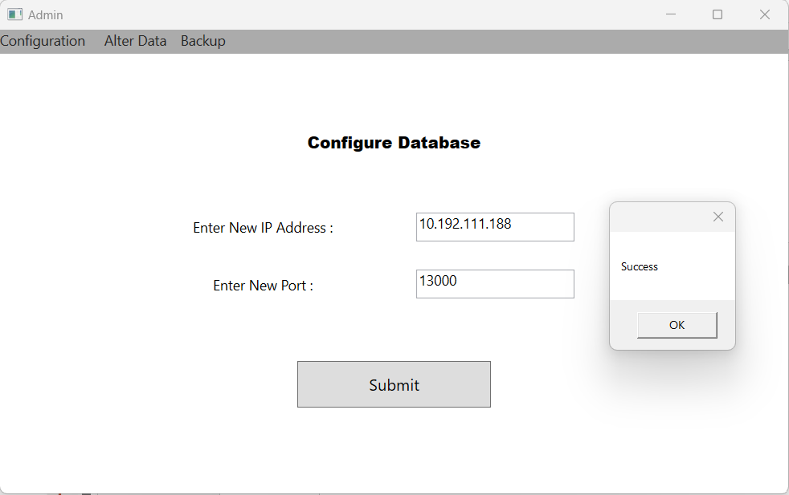
CONFIGURATION DATABSE CONTINUED

Slide 11
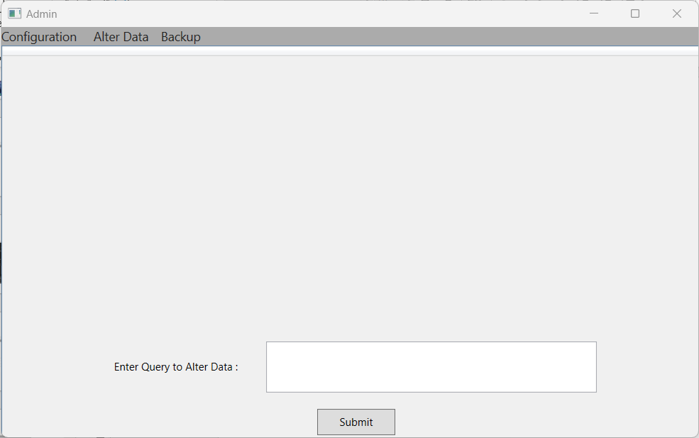
DATABASE OF TABLES

Slide 12
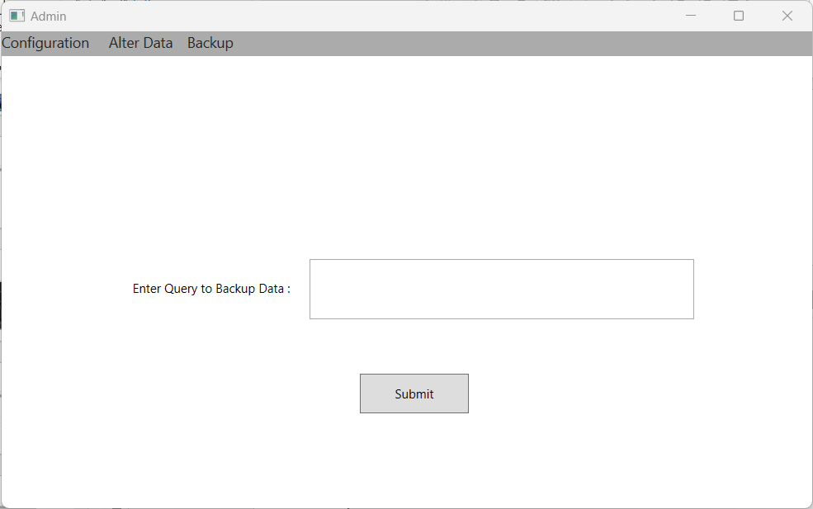
BACKUP DATABASE

Slide 13




BUYER

Slide 14
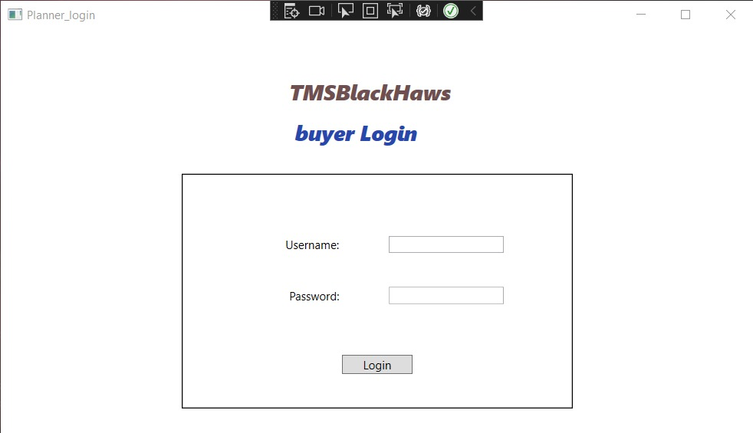
BUYER LOGIN PAGE

Slide 15
PLANNER

Slide 16
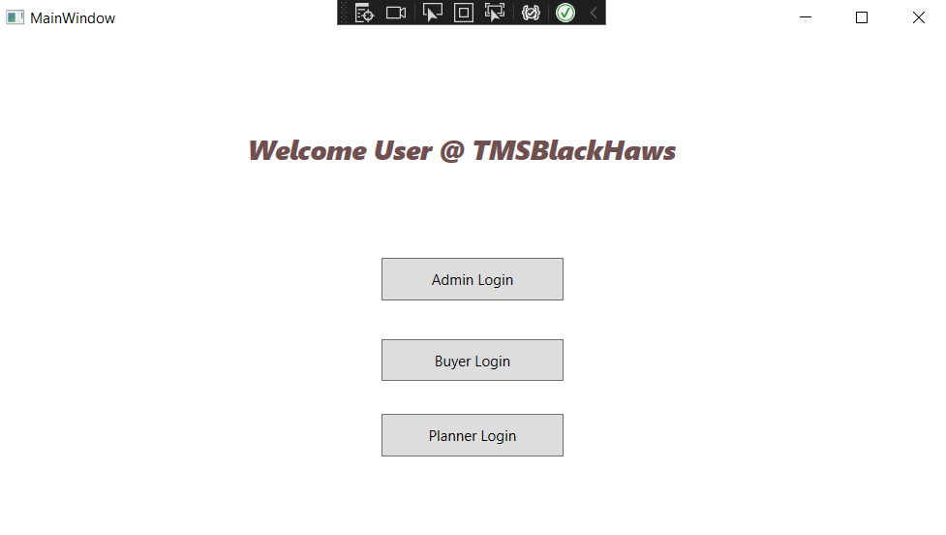
PLANNER MAIN LOGIN

Slide 17
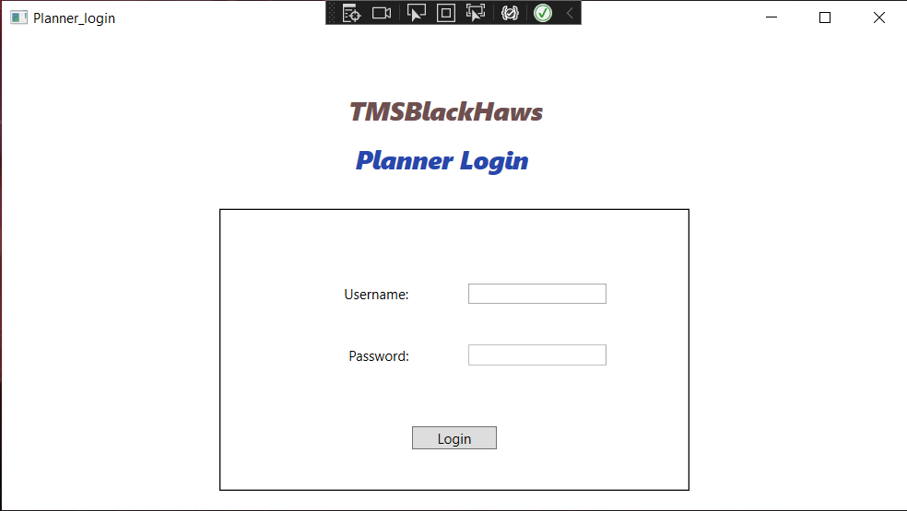
PLANNER LOGIN

Slide 18
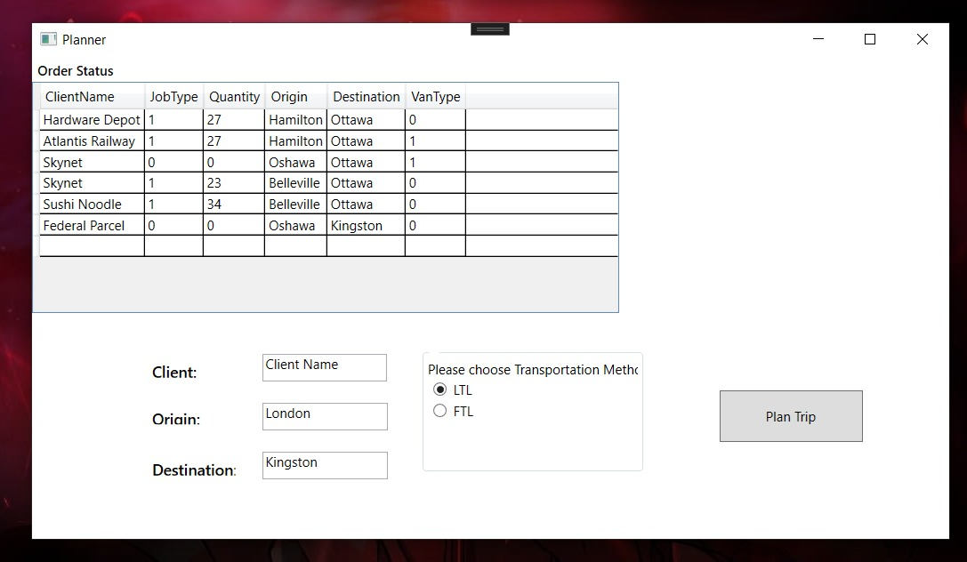
ACTIVE ORDER STATUS SCREEN

Slide 19
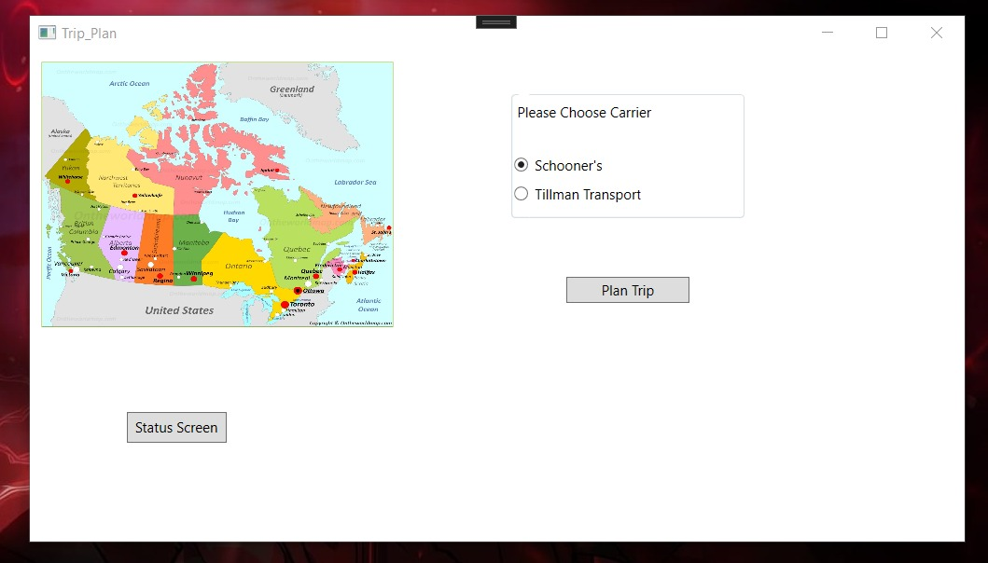
TRIP PLANNER SCREEN

Slide 20
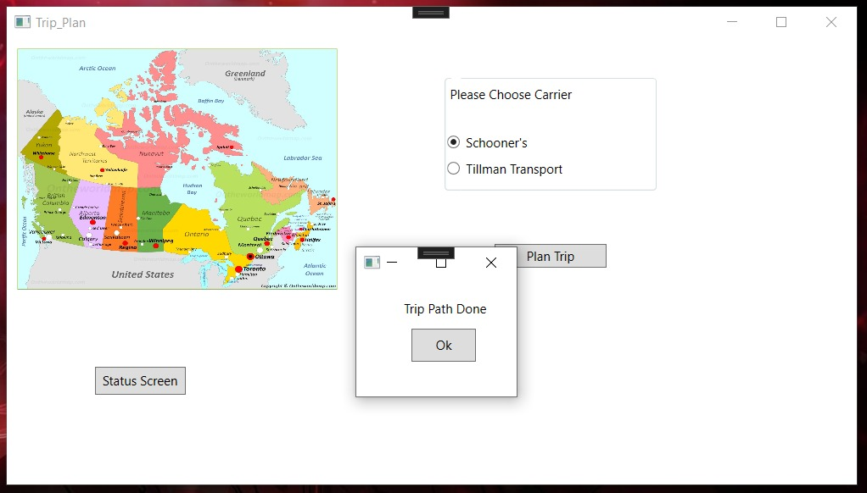
TRIP FINALISED SCREEN

Slide 21

DATABASE

Slide 22
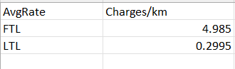
RATE- FEE DATABASE

Slide 23
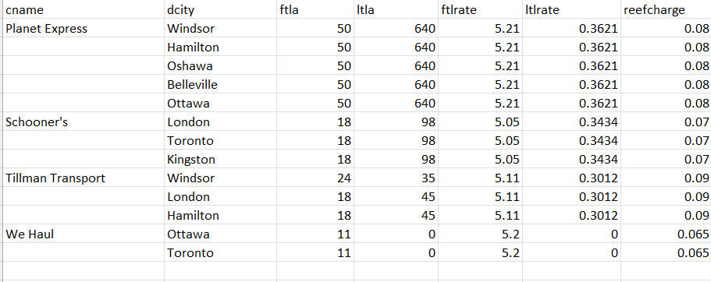
CARRIERS DATABASE

Slide 24
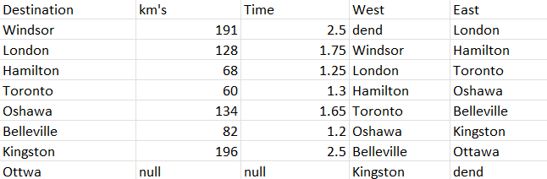
ROUTE DATABASE

Slide 25


